Slide 1
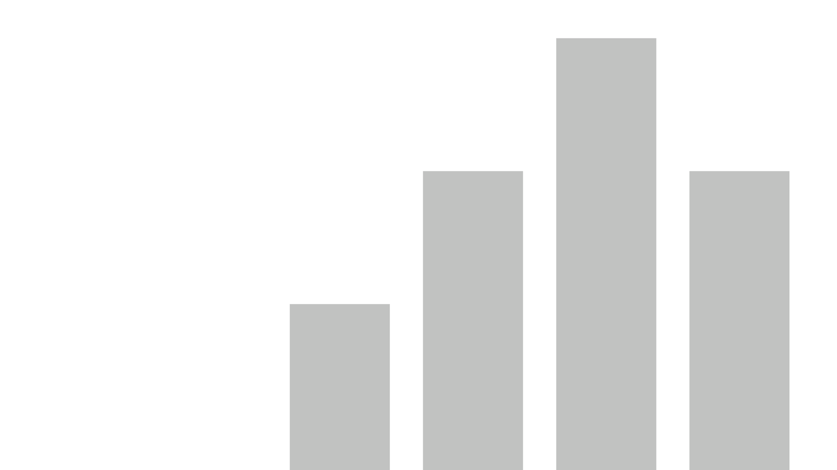


Brand`s traffic factors
View in Power BI
Last data refresh:
12/25/2020 1:33:40 AM GTB Standard Time
Downloaded at:
12/25/2020 1:35:40 AM GTB Standard Time

Slide 2
In this presentation we have explored the influence of media
and several macrofactors on traffic of some store called Brand.
Media influencers are:
Target Rating Point TB (Brand Promo variable)
Target Rating Point Out-Of-Home (different provinces of Ukraine)
Target Rating Point Radio (Brand variable)
Brand`s Competitors
Macrofactors:
Average salary
Holidays (Answering the question “does the current week
contain a holiday?”)
Exchange rate

Slide 3
You can read the algorithm of research on next slides in attached file “Algoritm.docx”.
Git repo link is here: https://github.com/Yagermaister/razom_task.git

Slide 4
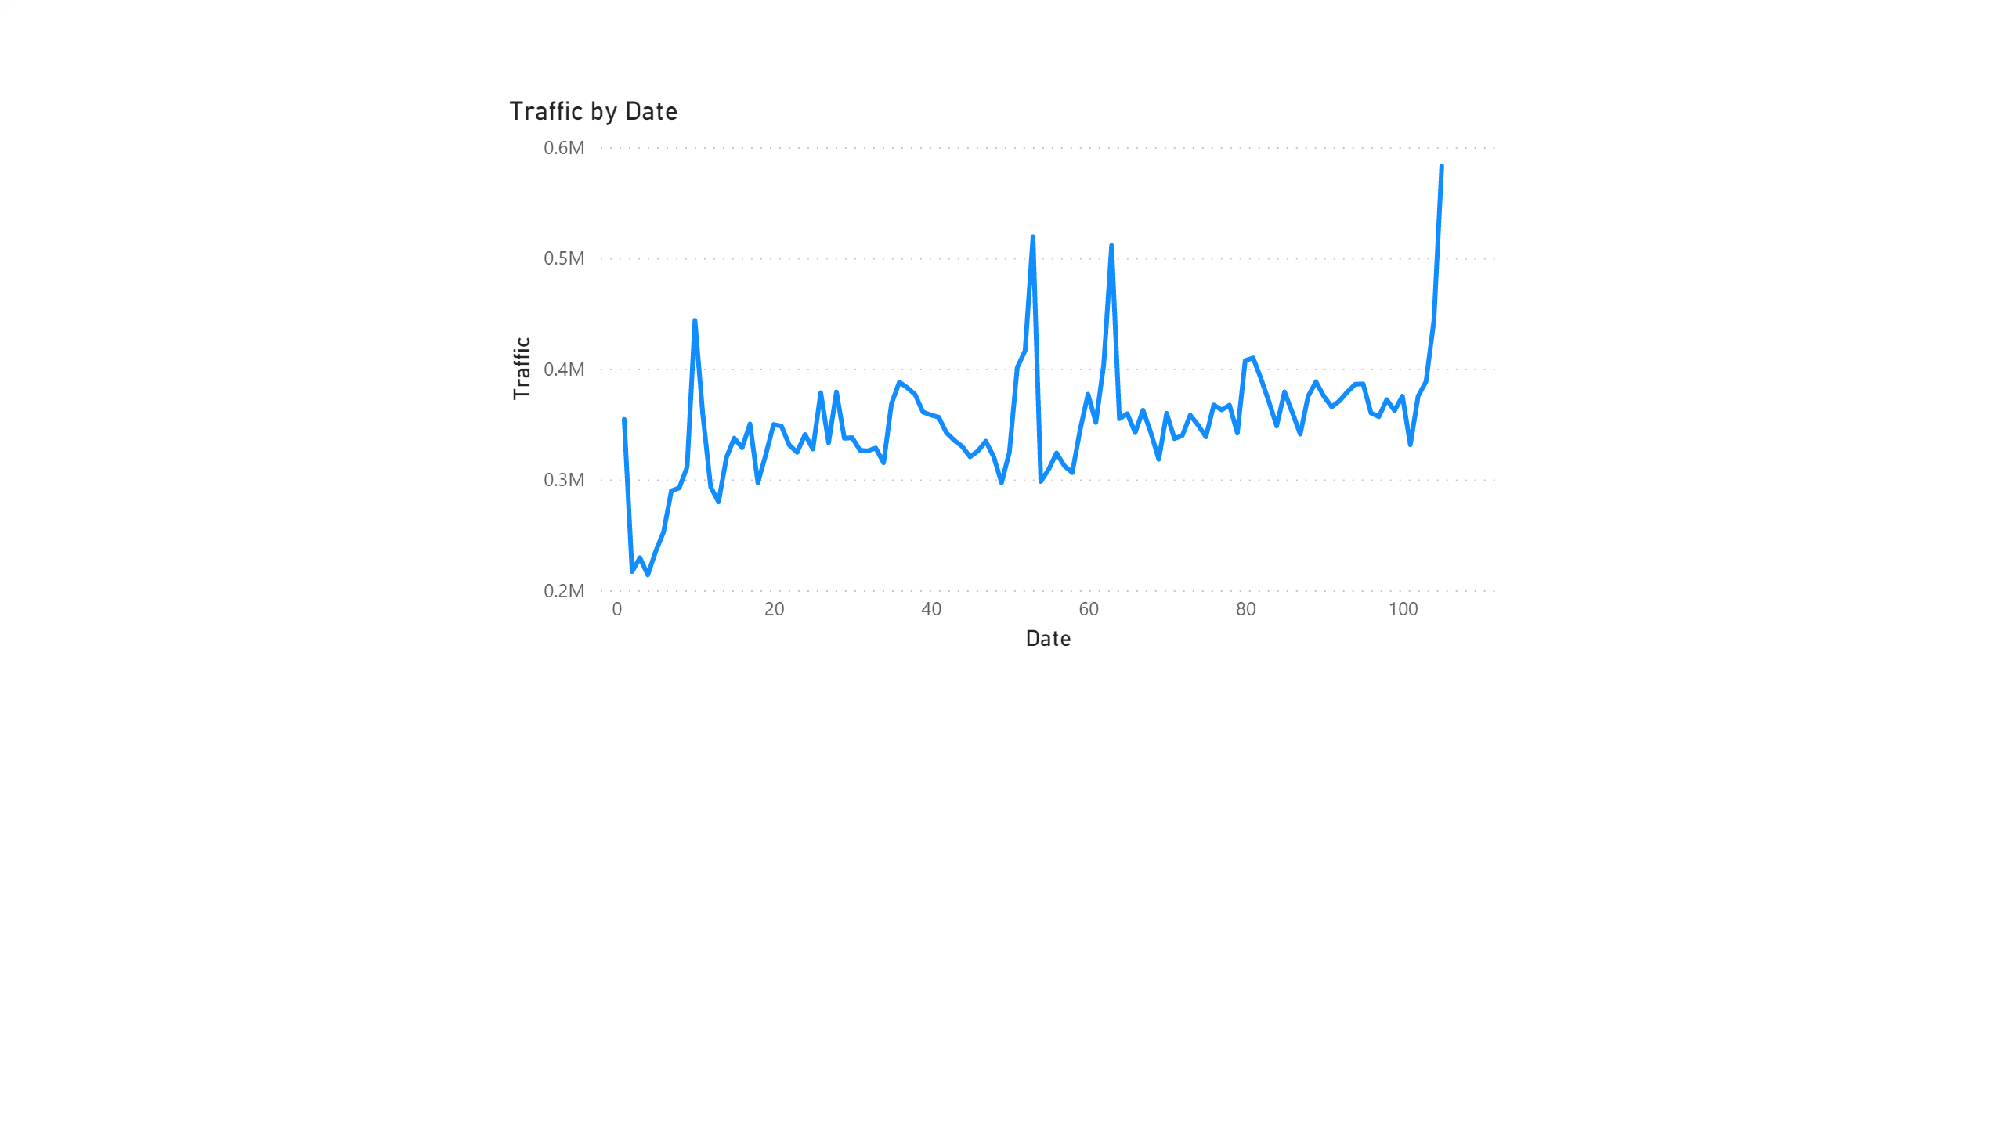
As we can see, Traffic increased during 2017 – 2018 (Date)
Important remark*: variable Date is represented by 105 weeks from 28.12.2016 to 31.12.2018
So the first element of Date means 28.12.2016 – 03.01.2017 period etc.

Slide 5
Firstly, let us analyze macrofactors.

Slide 6
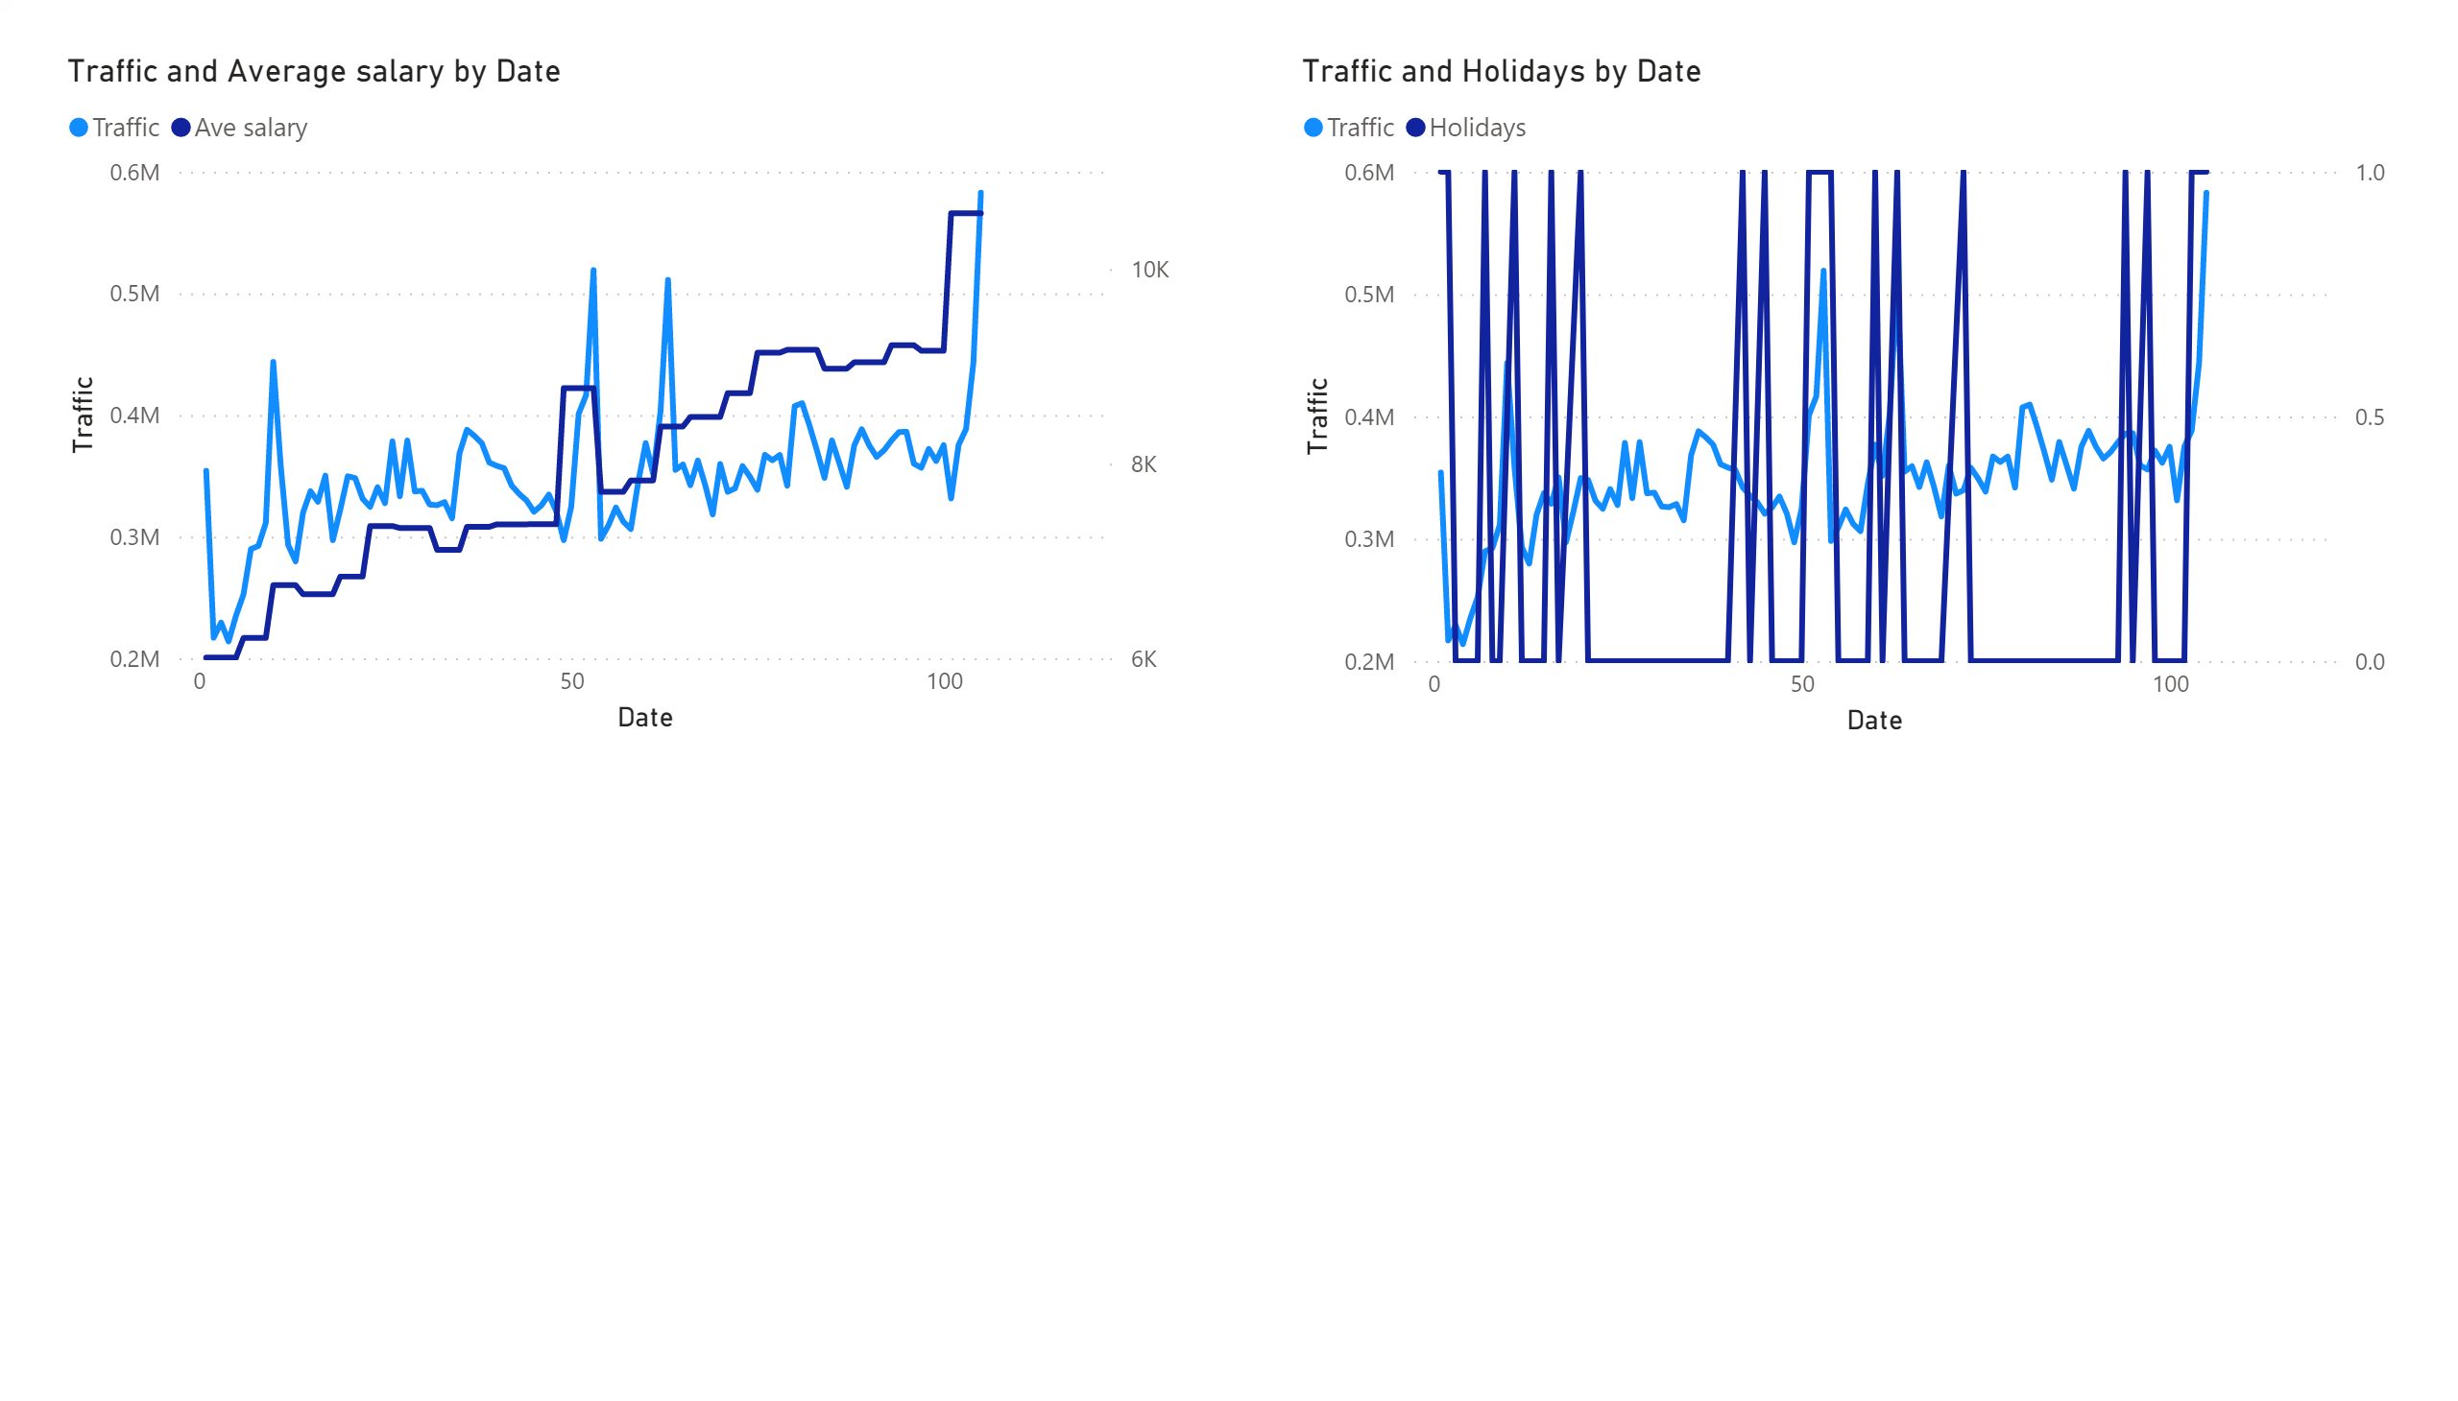
All in all, Average salary factor strongly influences the Traffic variable (this and further analyses You can read in file “Protocol.docx”)
Holidays factor influences the Traffic variable.

Slide 7
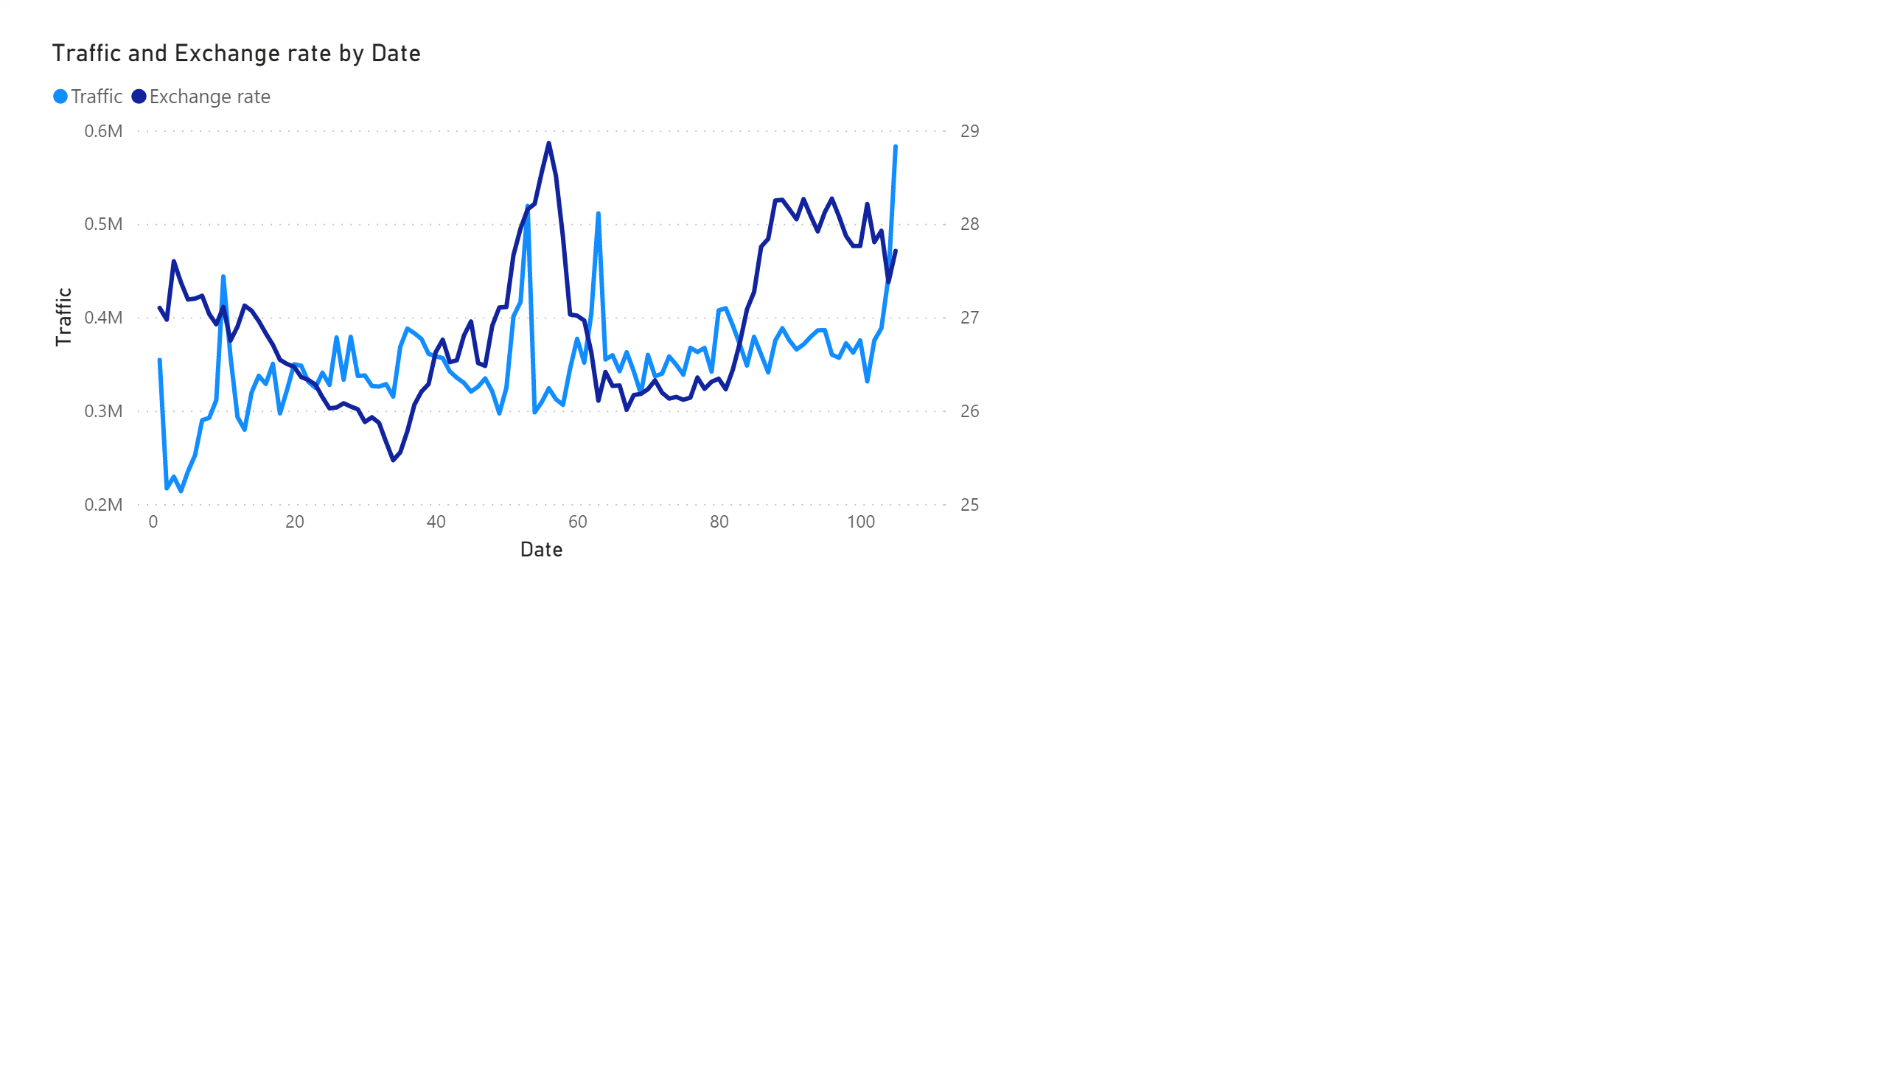
Exchange rate factor likely does not influence the Traffic variable.

Slide 8
Secondly, let us consider TRP Radio, TB and OOH factors.

Slide 9
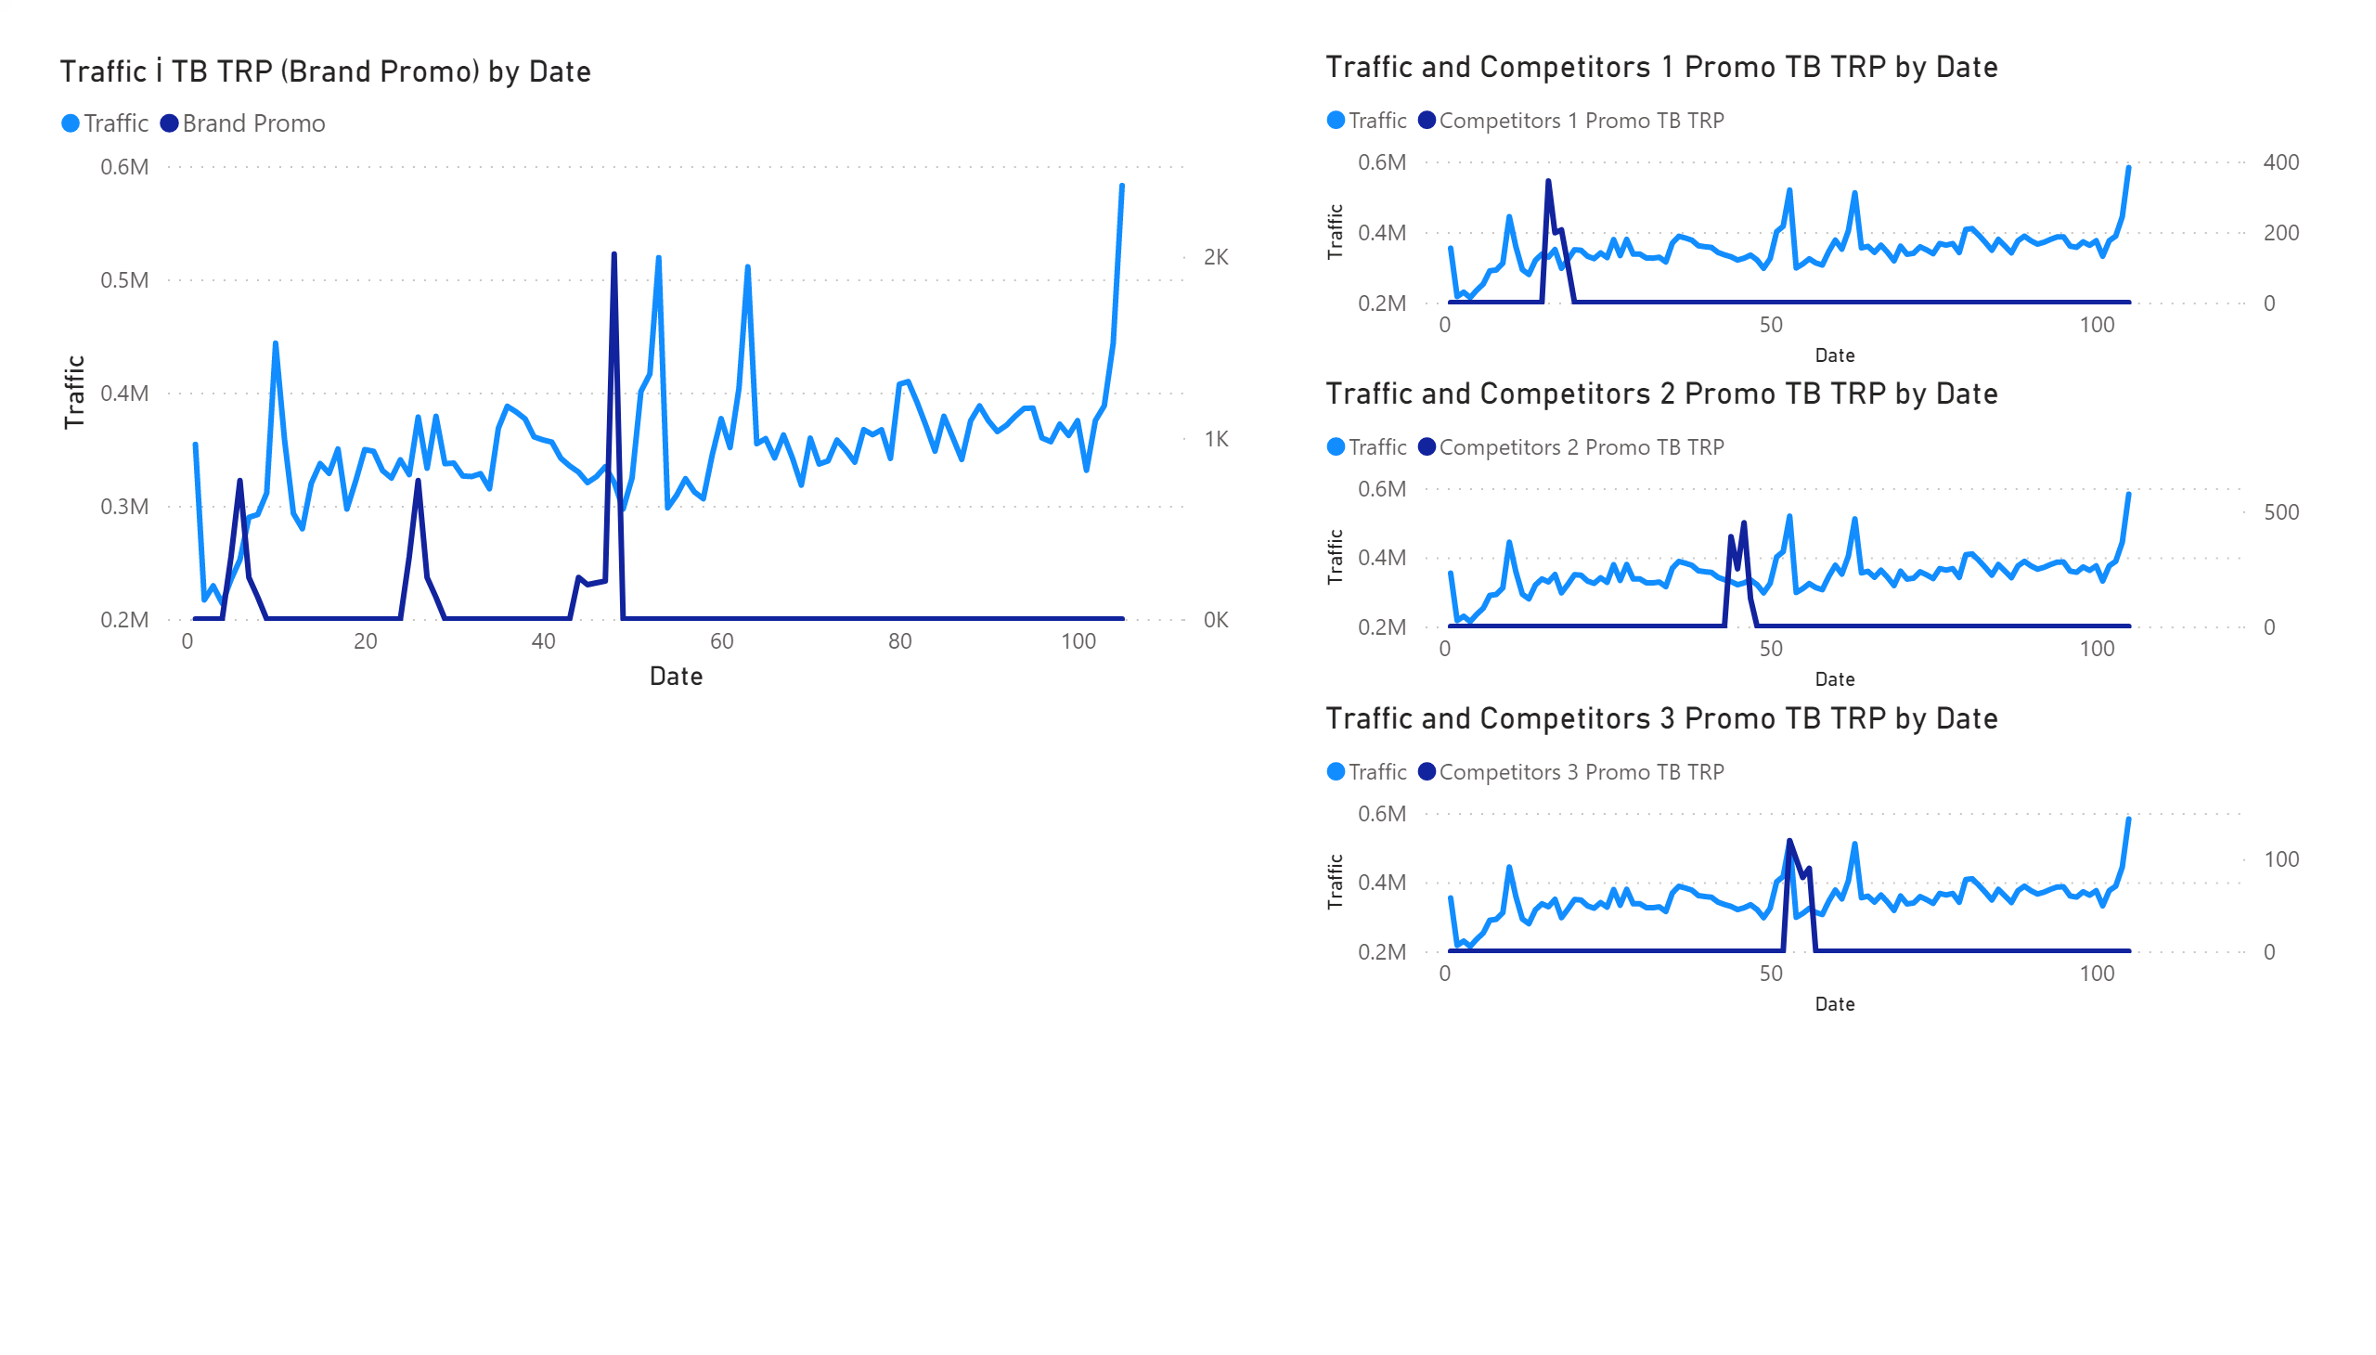
TB TRP factor likely does not influence the Traffic variable.
Our competitors definitely badly influence Traffic of the Brand.

Slide 10
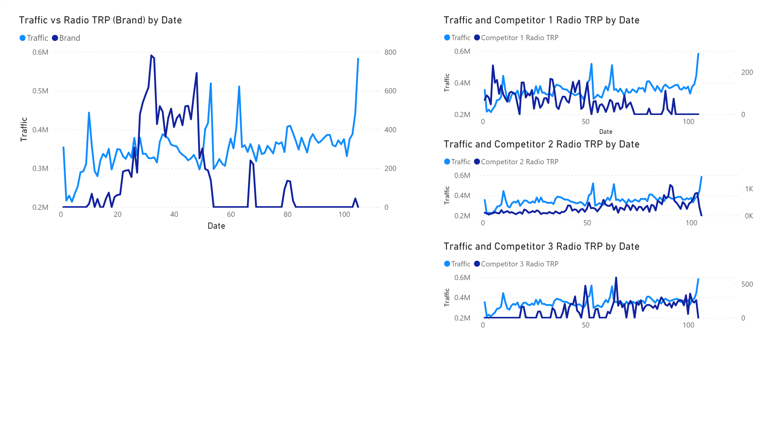
Radio TRP factor slightly influenced the Traffic variable.
Competitor 1 definitely badly influences Traffic of the Brand, others – do not.

Slide 11
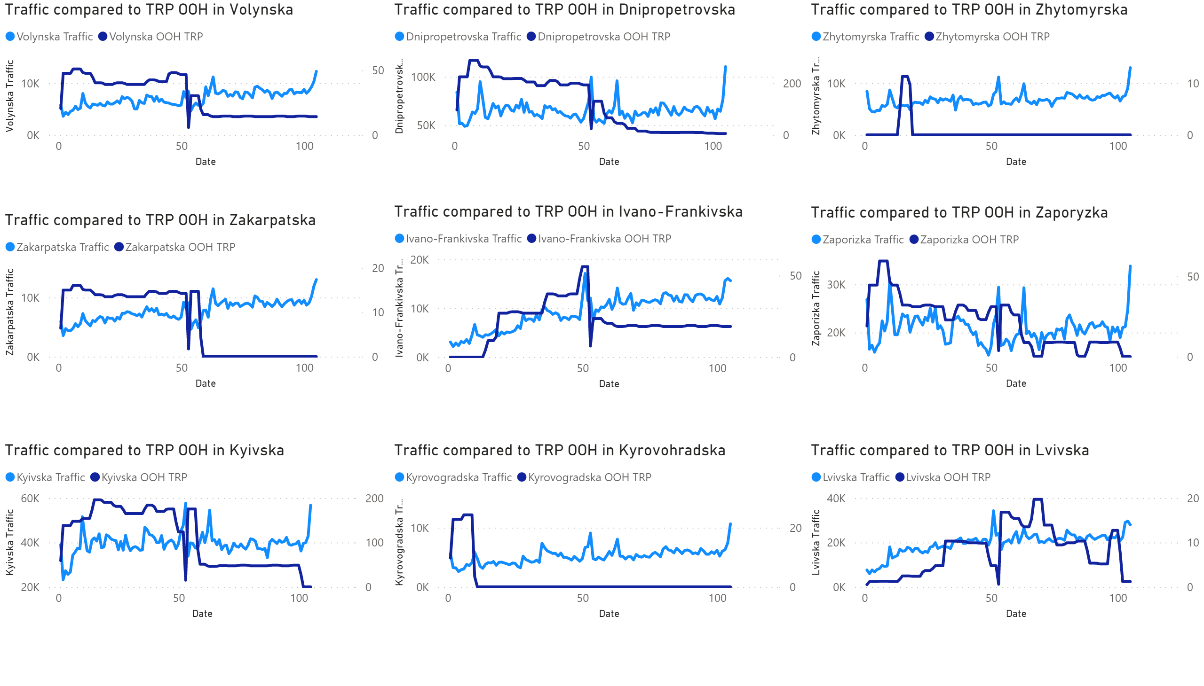
Inversely correlated
Not correlated
Not correlated
Inversely correlated
Correlated
Not correlated
Not correlated
Correlated
Correlated

Slide 12
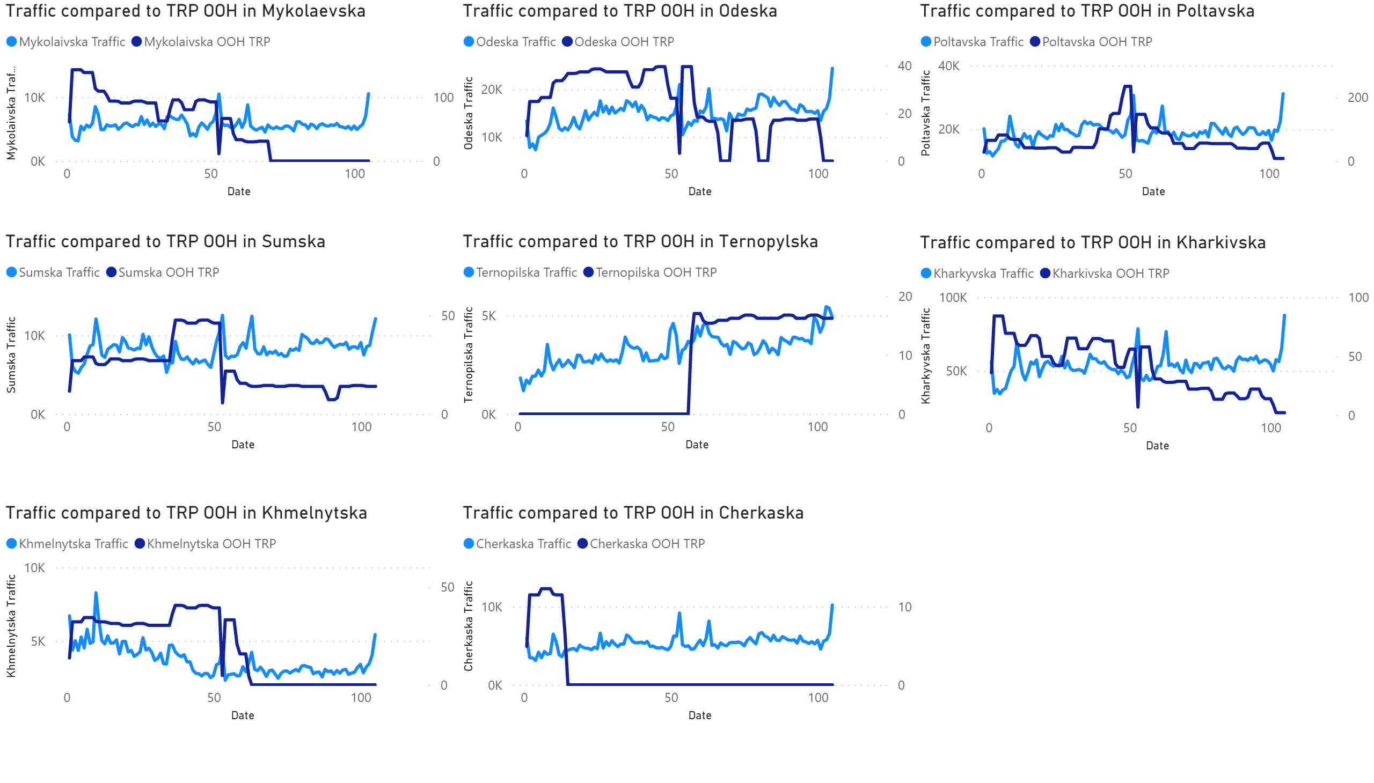
Not correlated
Inversely correlated
Not correlated
Inversely correlated
Correlated
Inversely correlated
Correlated
Inversely correlated

Slide 13
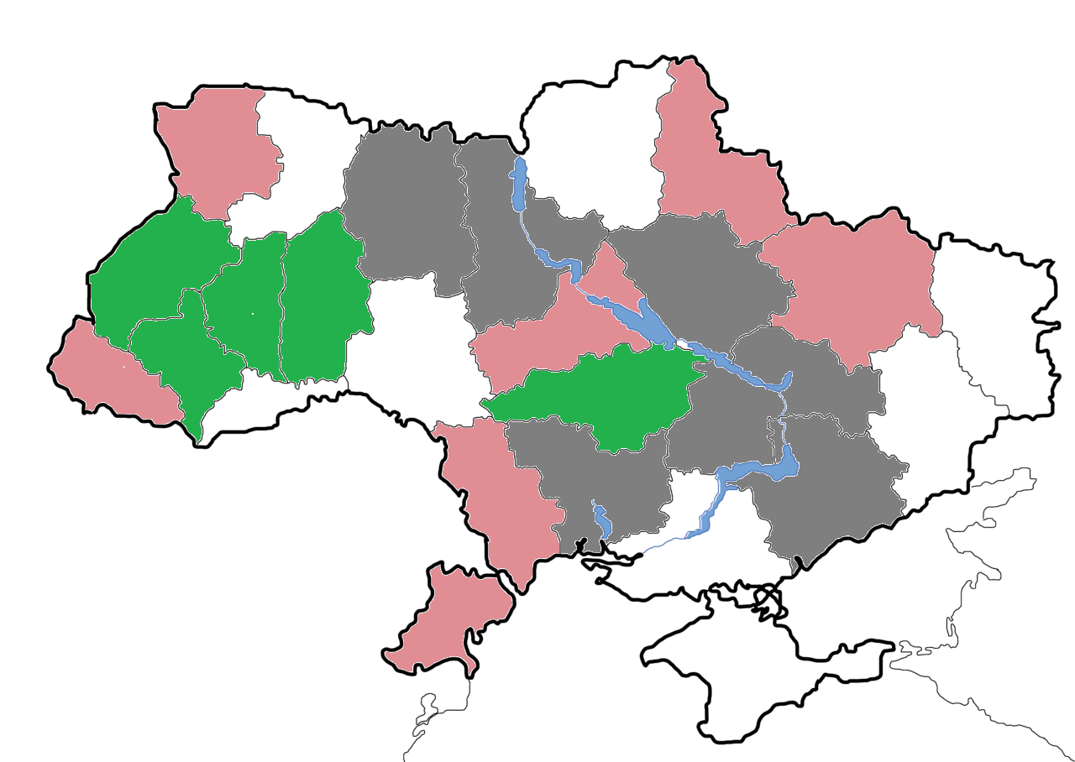
So OOH TRP correlates with Traffic
in 5 provinces (marked green on the map)
Inversely correlates with 6 provinces
(red on the map)
And does not correlate at all in
7 provinces (gray on the map)
Provinces marked white do not
participate in analysis.

Slide 14
Conclusions
As a result of the analysis we can state:
Traffic was influenced by macrofactors Average salary and Holidays, but was not influenced by Exchange rate.
Traffic was influenced by placing in media Radio, but was not noticeably influenced by placing in media TB.
In addition, local traffic increased after placing in out-of-home media in Lvivska, Ternopilska, Ivano-Frankivska, Khmelnytska and Kirovogradska provinces.
Competitor 1 badly influenced Traffic of our Brand (especially by using Radio), Competitors 2 and 3 did not noticeably influence Brand`s traffic.

Slide 15
Thanks for your attention!

